Slide 1

JAVA MINI PROJECT
INVOICE BILLING SYSTEM

Slide 2
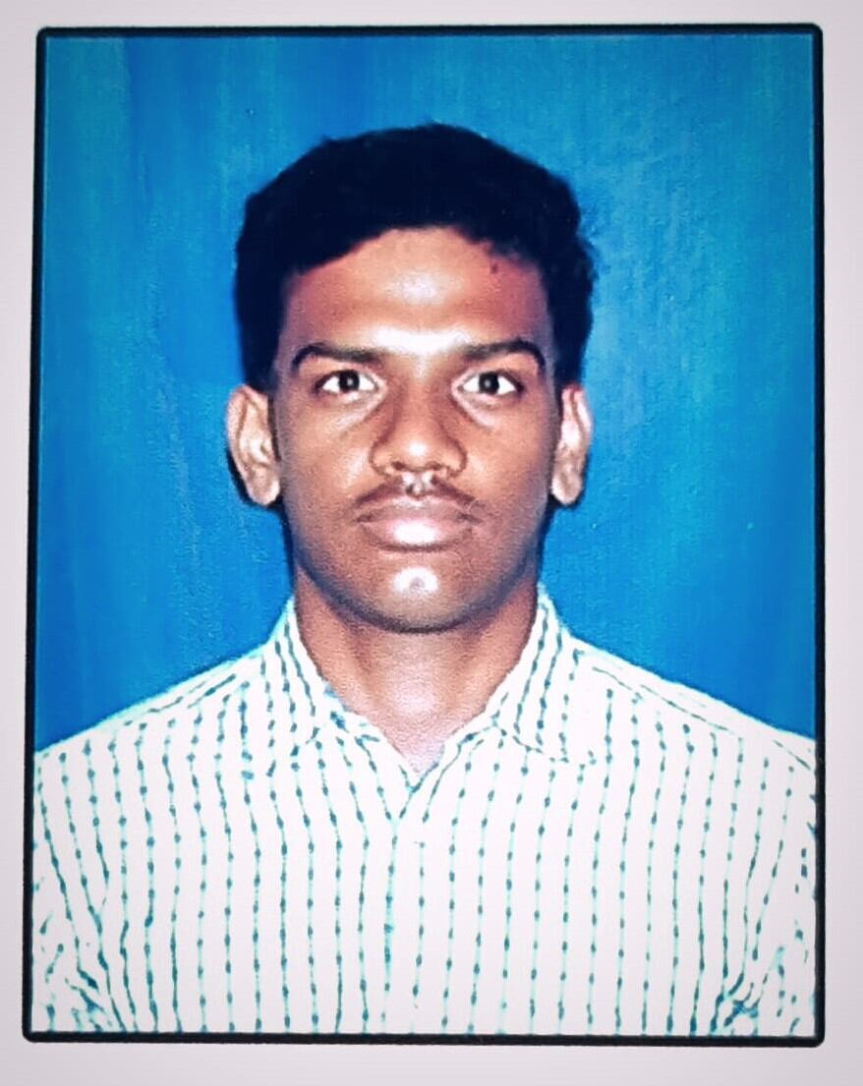
DONE BY
S.MOHAN KUMAR
CSE(AIML)
B.TECH (SECOND YEAR)
KALASALINGAM UNIVERSITY
Mail id:sampatiraomohankumar@gmail.com

Slide 3
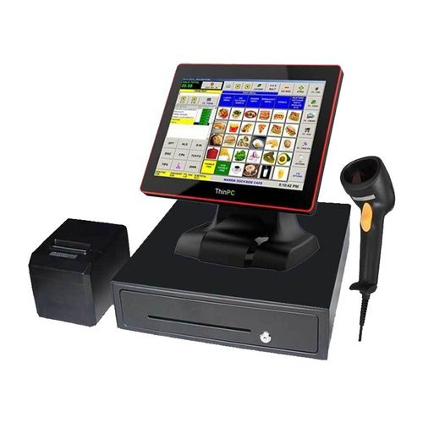
Table of Contents
Objective of our Project
Abstract
Introduction
Existing System
Proposed System
Advantages
Output
Conclusion

Slide 4
OBJECTIVE OF OUR PROJECT
The main objective of our Project is to print the bill of the purchased items by the customers.
The project is based on the concept of calculating the total bill of the and generating invoice of the customer.
This billing system manage item name, quantity, price and total amount of the customer.

Slide 5
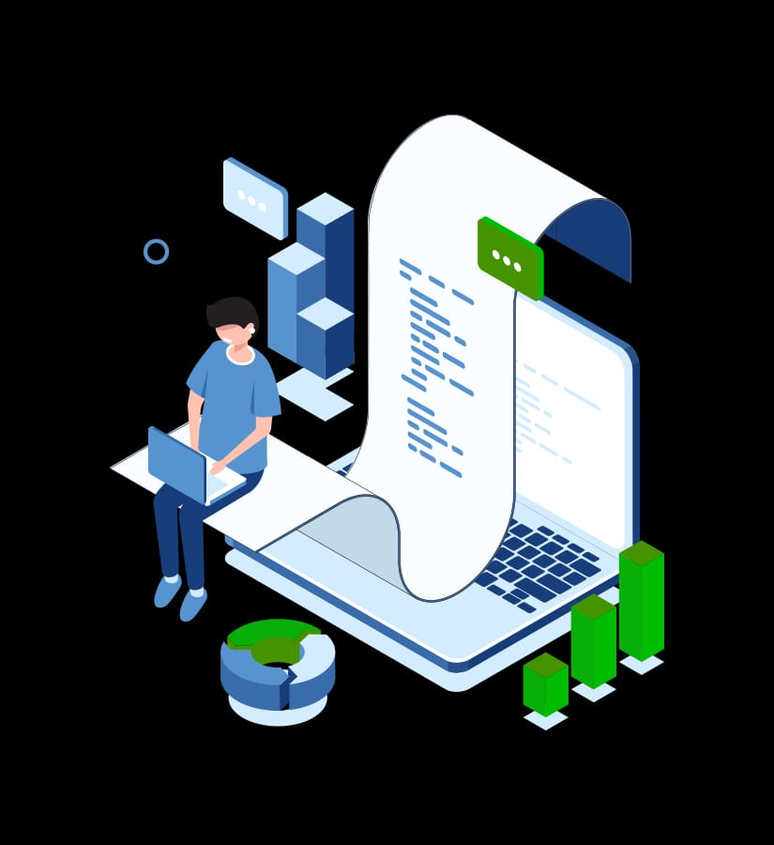
ABSTRACT:
Invoice System is a Web Application which makes the business work easy. The Invoice system is an excellent way to record details of the Customer in an easy and efficient manner. This system replaces the current system where customer details and product details are written manually with a pen and is given to the customer in the form of a Receipt.

Slide 6
The online Billing application is providing with efficient GUI to the user and can be installed in other systems easily. A billing System includes procedures and processes that help to create bills and invoices for customers. Nowadays , billing systems include software that allows transmitting bills and invoices to the customers offline and online.
INTRODUCTION

Slide 7
ABOUT OUR PROJECT
This invoice and Billing System in java project is developed using Netbeans IDE. The Project is based on the concept of calculating the total bill of the and generating the invoice of the customer. Talking about the project, it contains less but important features. A user can select any category, CRUD items before calculating the bill. . With the help of E-Billing System, the customer details are recorded in a Computer and the Computer generates an Invoice which contains the Products which Customer has bought and the Invoice includes everything like when the purchase is made, what products are bought, Billed amount etc. This e-Billing system is easy to use and doesn’t require huge amount of money to Maintain. In to manage billings, he/she has to select a category item name, quantity, item price. Design of this is so simple that the user won’t find difficulties while working on it. This project is easy to operate and understood by the users. To run this project you must have installed Netbeans IDE on your PC.

Slide 8

PROJECT IMPLEMENTATION
EXISTING SYSTEM
PROPOSED SYSTEM
The client uses a Receipt Book to record details of the customer and takes the details of the items bought and Fills it manually using a pen. This is an old Technique and isn’t preferable these days. Moreover the records cannot be saved for future and if owner needs to search for Previous Records it takes much time to search for all records and Increases burden. Hence to solve all these problems, the e-Billing and Invoice System is Preferable to use.
The Invoice System is easy to use and Maintain. Client enters all the details that are needed for the customer in the Software and an Invoice is generated containing all the Details of the Purchase. All the records are stored in a Database. This System records all the details like Item name, Quantity, Item Price, Total Amount Paid etc. Hence this system is an excellent way to record Customer Purchase Details.

Slide 9
RESULT ANALYSIS
Here are the 5 most important things to look for on an invoice:
The Vendor's Contact Information.
The Purchase Order Number.
Invoice Number.
Description and Pricing.
Payment Terms.

Slide 10
CONCEPTS COVERED
Java basics
Objects and classes
Inheritance
Interfaces
Arrays and strings
Exception handling
Multithreading
Event handling
Swing and awt

Slide 11
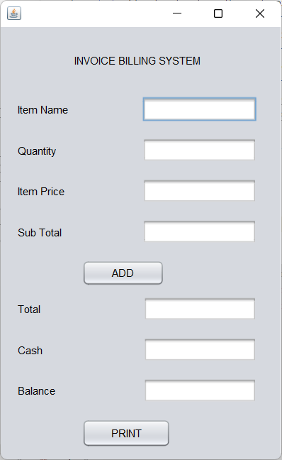
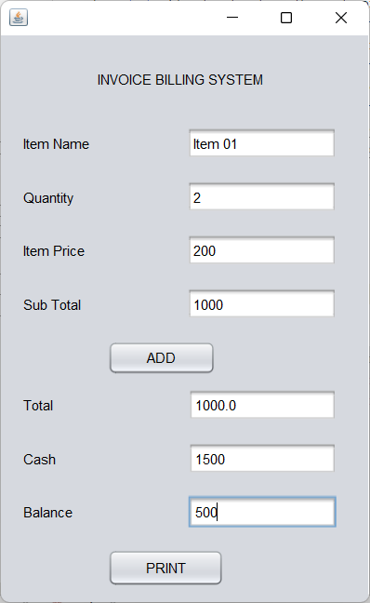
OUTPUT

Slide 12
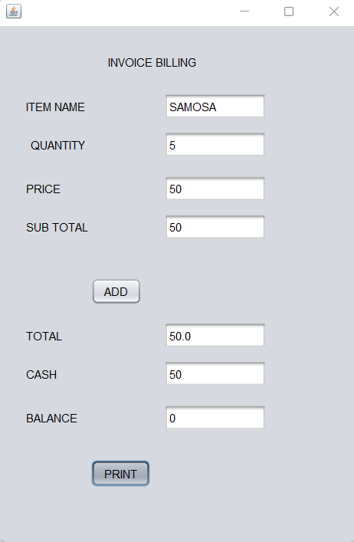
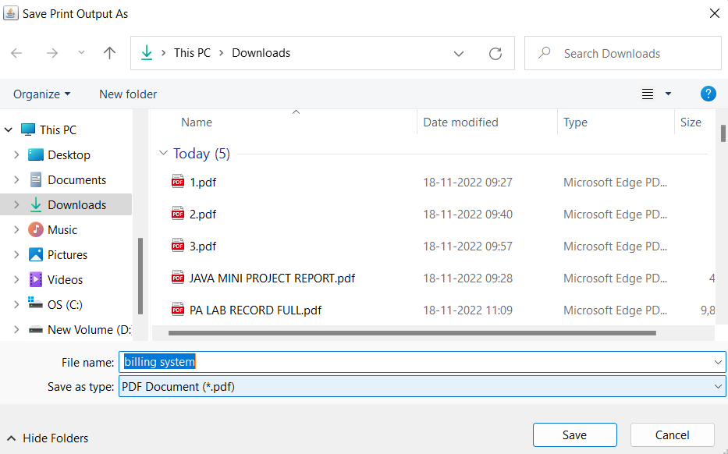
OUTPUT:

Slide 13
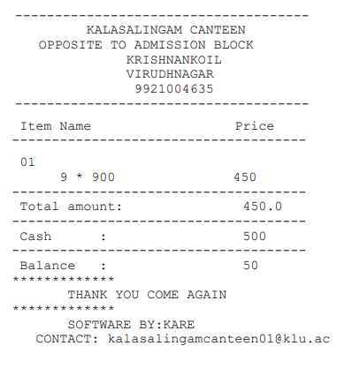
OUTPUT

Slide 14
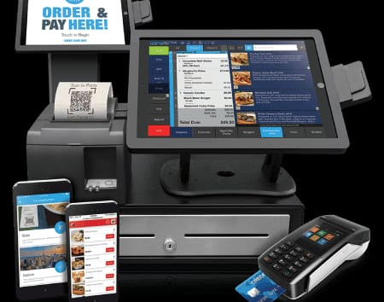
CONCLUSION
This Invoice billing system will manage customer purchase information by which they select items/goods. This system will incorporate all features of invoice system. Billing store in a database and result is displayed by the calculation. Finally, this system is very useful for the customers and users to print bills instead of pen writing.

Slide 15
REFERENCES
https://www.freshbooks.com/hub/invoicing/reading-invoices
https://docs.oracle.com › CDMAA › ba_addon
https://cleartax.in › Invoicing-Billing

Slide 16
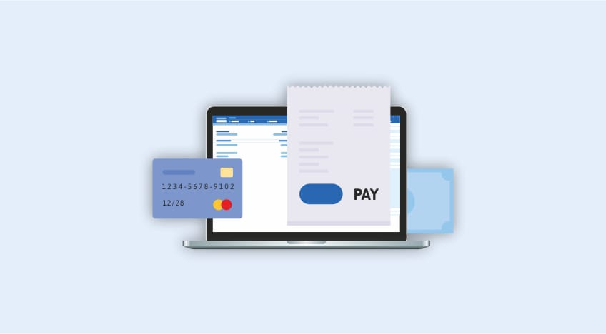
THANK YOU
THANK YOU

